Slide 1

Desiring SUVs:
Masculinities, Masculine Overcompensation, & Gender Segregation in Academic Libraries
Matthew Weirick Johnson
Librarian for English & History
pronouns: matty/they/he
twitter: @xoxoMattyBoy

Slide 2
Overview
Introduction
Masculinity
Organizational theory
Devaluation & Care Work
Vertical & horizontal gender segregation
Masculine overcompensation theory

Slide 3

Masculinity
A hierarchical structure with a dominant hegemonic masculinity at the top (Connell & Connell, 2005)
Men work to make women and other men seem inferior as a way of maintaining their own masculinity and thus maintaining their position within the masculine hierarchy
With permission of artist

Slide 4
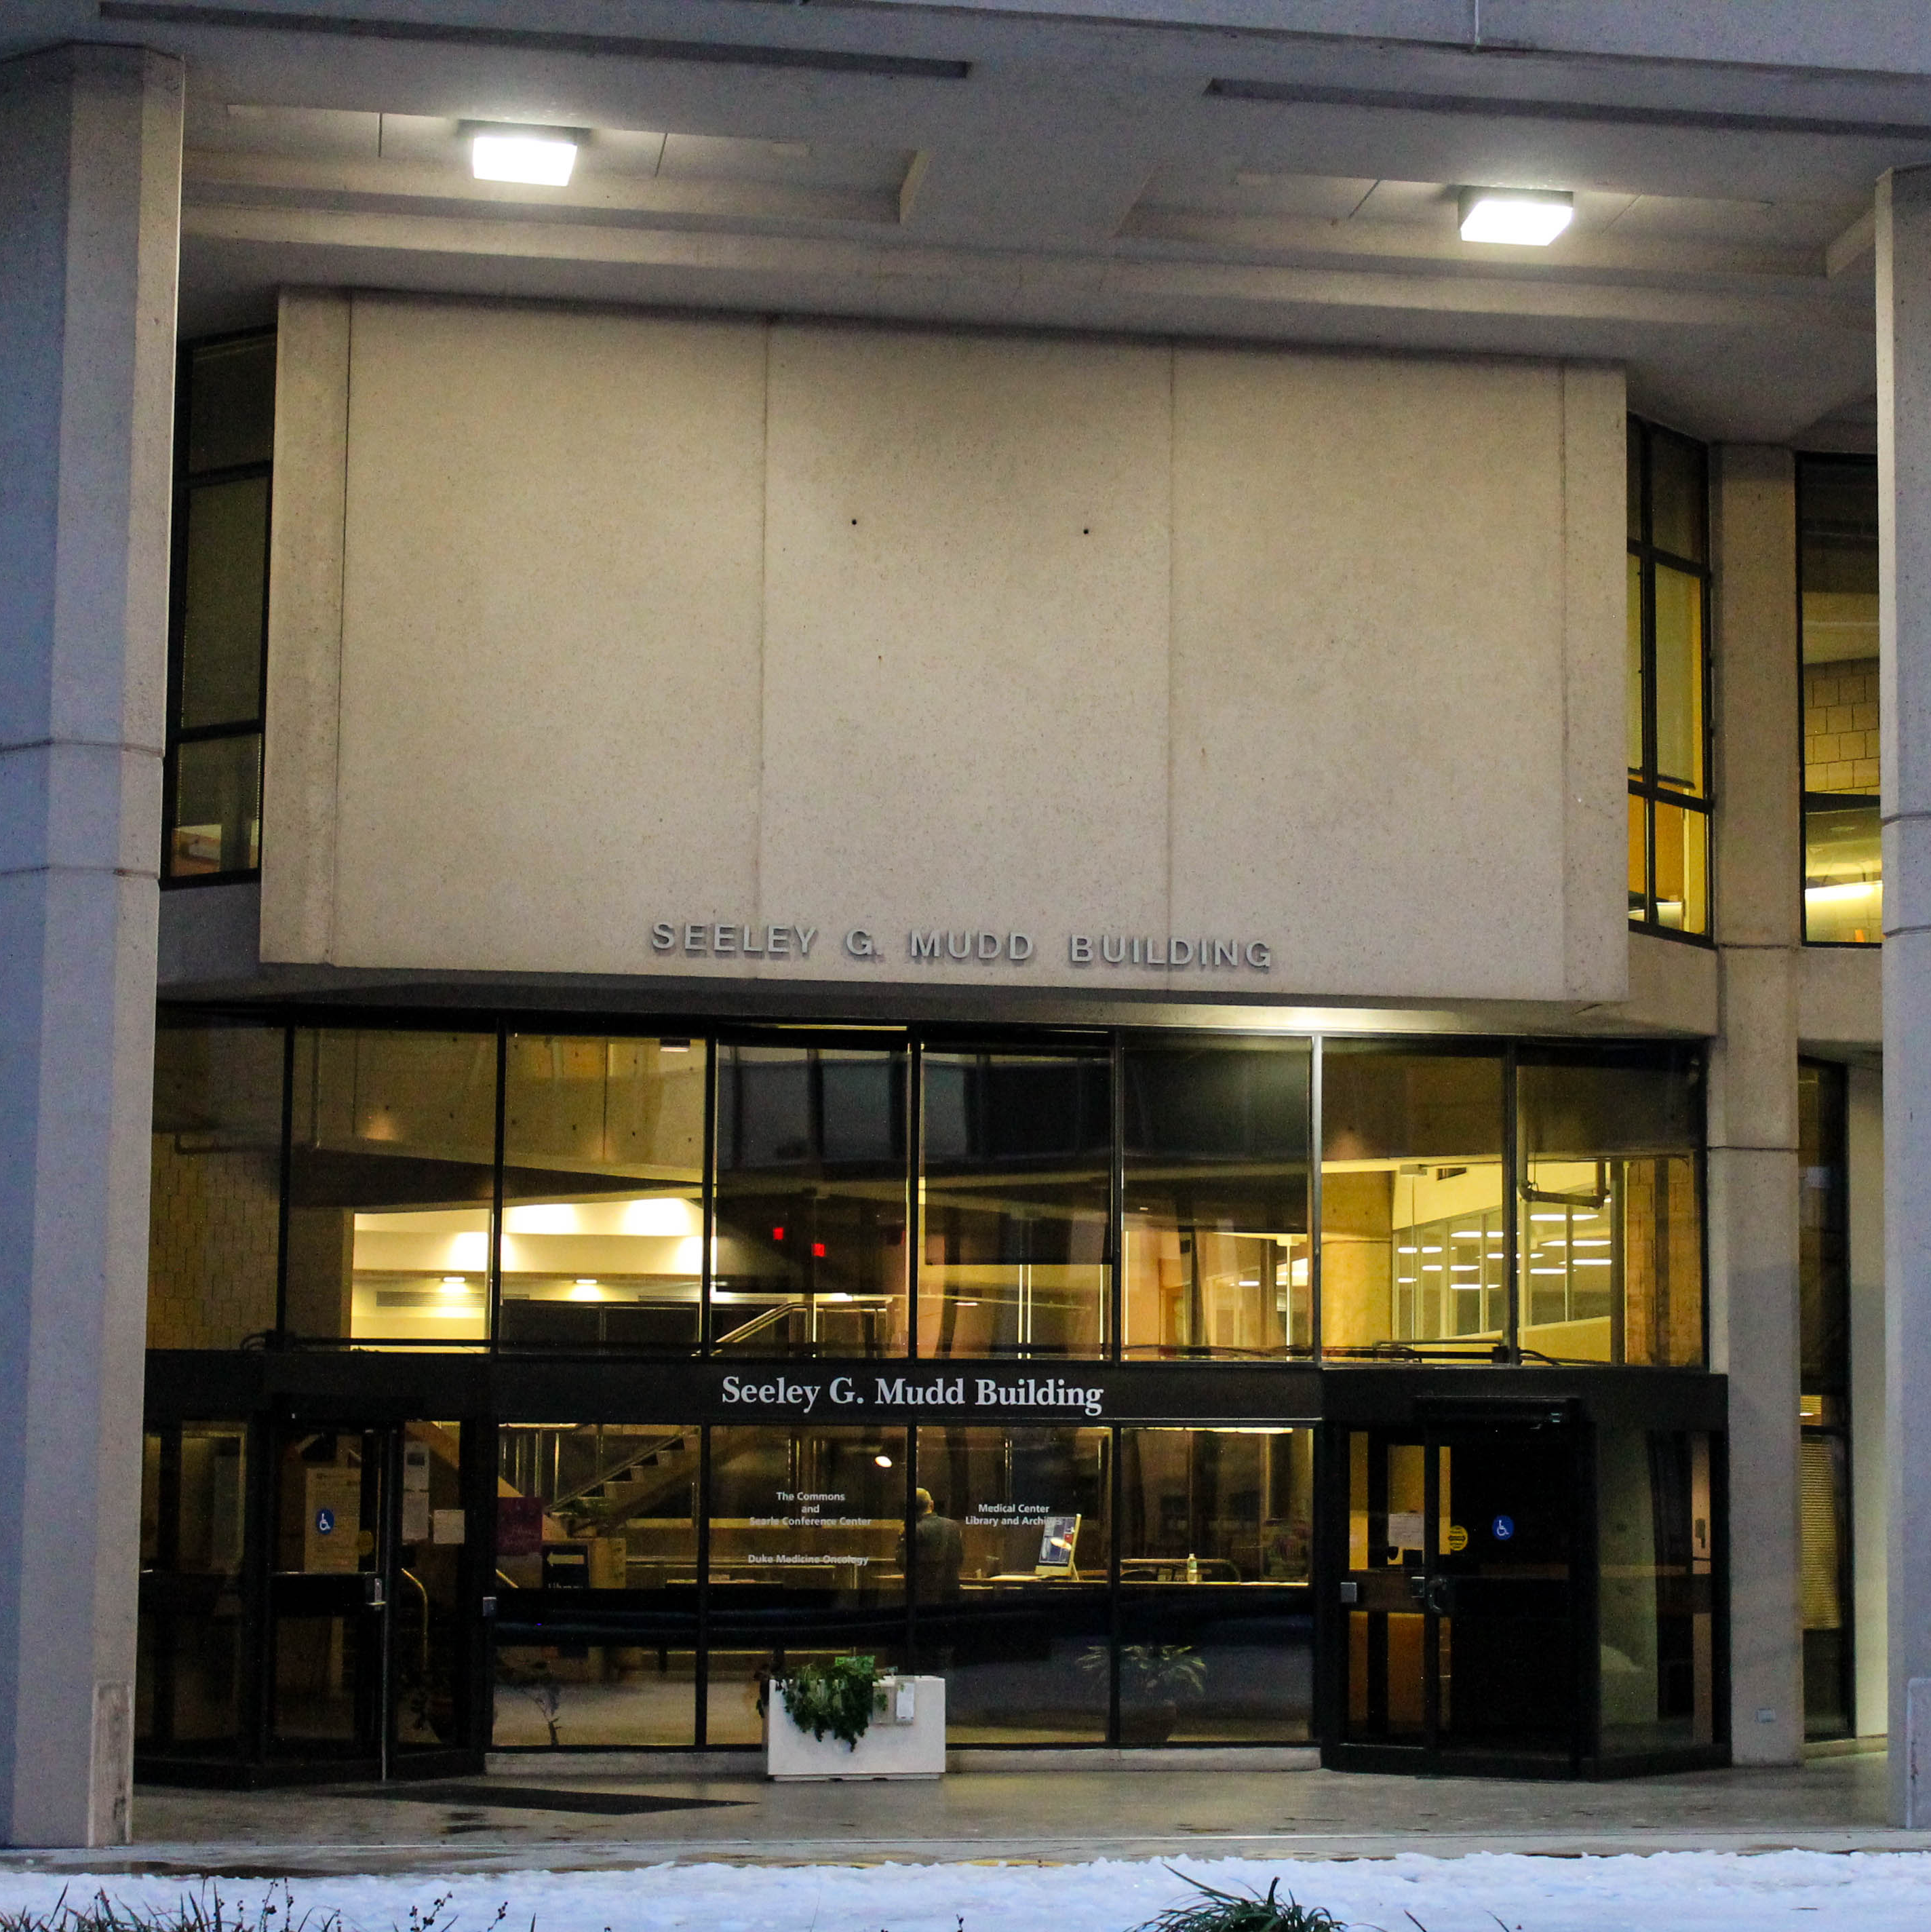
Organizational Theory
Organizations assume a neutral position of masculinity that perpetually privileges men, men’s abilities, and skills not readily available to women (Reskin,1988; Acker, 1990)
Primary issue in organizations is men’s desire to retain the dominant position; gender segregation is a symptom
Photo by presenter

Slide 5

Devaluation & Care Work
Work is assumed to be either skilled or unskilled based on the gender of the individual completing the work
Caring is reframed as an innate skill gendered as feminine to devalue
Access to skill aggregation is limited (Reskin, 1988, p. 72).
Photo by presenter

Slide 6

Vertical Gender Segregation

Slide 7
Horizontal Gender Segregation

Slide 8

Black Male Nurses
Significantly different treatment of Black male nurses than previous research would suggest with white male nurses (Harvey Wingfield, 2009, 2010; more in notes)
Black male nurses accept the role of caring more so than white male nurses, suggesting that they accept this part of feminized labor as opposed to rejecting it
Photo by presenter

Slide 9
Reductive Gender Models
Male
Female

Slide 10
Intersectionality
Sexuality
Men of color, men with disabilities, gay or queer men, and trans men all appear to have unequal access to the glass escalator (Harvey Wingfield & Myles, 2014; Williams, 2013; Woodhams, Lupton, & Cowling, 2015)
Gender
Race
Disability

Slide 11

Masculine Overcompensation
“Men who fear they have insufficient masculinity overcompensate by enacting extreme masculine behaviors and attitudes designed to create the impression that they are quite masculine” (2013, p. 982)
Photo by Jamie Street on Unsplash

Slide 12
Thank You

Slide 13






Matthew Weirick Johnson
academic.mattweirick.com
matt@mattweirick.com
academic.mattweirick.com/files/ideal19-presentation-20190807.pptx
academic.mattweirick.com/talks/2019-08-07-ideal19-presentation

